Slide 1
Theory, Practice and
Future of LLMs
Denison University
Computer Science and Math Departments
2 Nov 2023
Jon Chun
Kenyon College
jonachun.com
@jonchun2000

Slide 2
Teaching
First human-centered AI curriculum (2016)
300+ Mentored student research at digital.kenyon.edu/dh
Interdisciplinary Research
APQ: Novel Jailbreak Ethical Reasoning Benchmarks of 12 Leading LLM
IJDH: Novel GreyBox Ensemble eXplainable AI
Spring Nature IJHAC: AI Challenges and Interdisciplinary Curriculum
(current): LLM Affective AI, Synthetic Data, Small 7B-13B Open LLMs
Presentations
Limits of Cognition (Theoretical CS)
Medical Applications of AI (FDA association)
Manufacturing Engineering/Physics Simulation (Synthetic Time Series)
Higher Ed (Interdisciplinary AI)
Consulting
Finance (VC, Private Equity, Industry)
Startup Consultant
Industry
Silicon Valley Startups to Fortune 500 Director of Development (Sale Engineer to Patents)
Computer Security, FinTech, MedTech, InsurTech, Semiconductors: US, Asian and Latin America
Paper/Book Reviews, Grants, Non-Profit, jonachun.com and Tweets @jonchun2000

Slide 3
Overview
History
Theory
Information
Representation
Learning
Reasoning
Practice
Transformers Architecture
Inference vs Training
Future

Slide 4
History

Slide 5
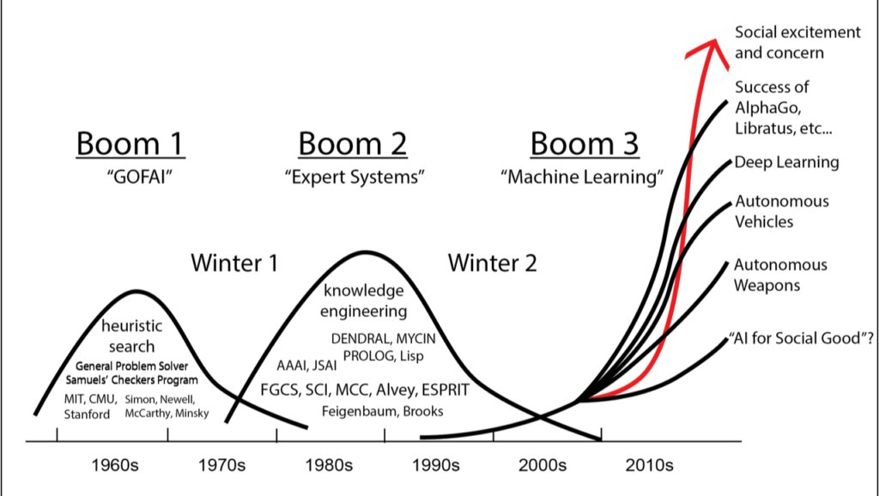

Is This Time
Different?

Slide 6
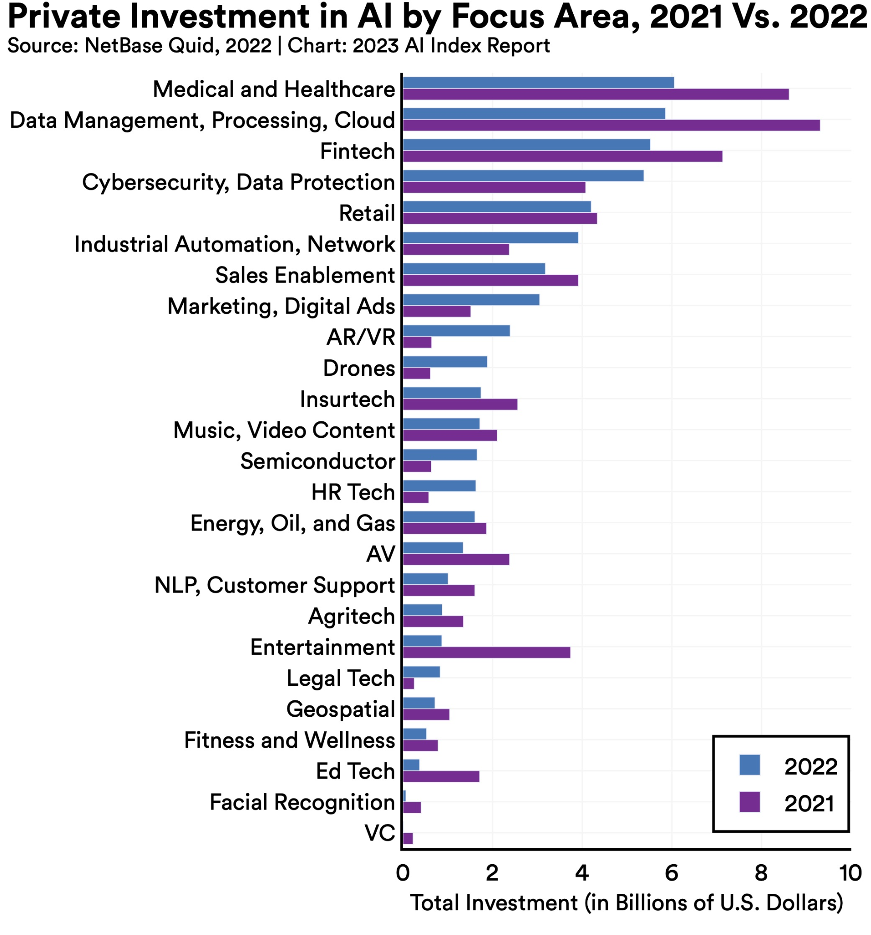
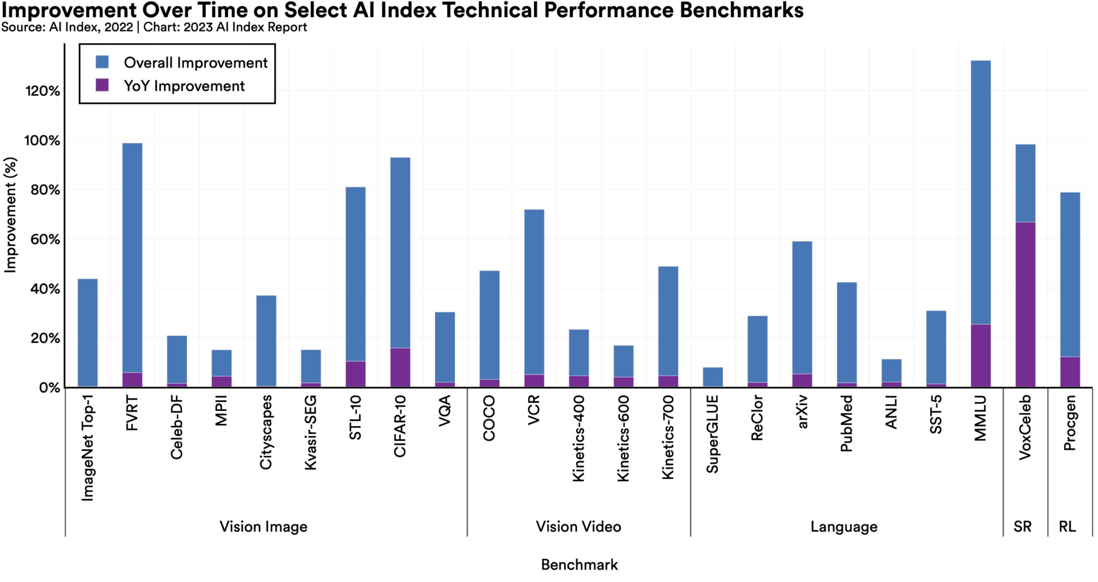
Towards AGI
Notes:
https://aiindex.stanford.edu/report/

Slide 7
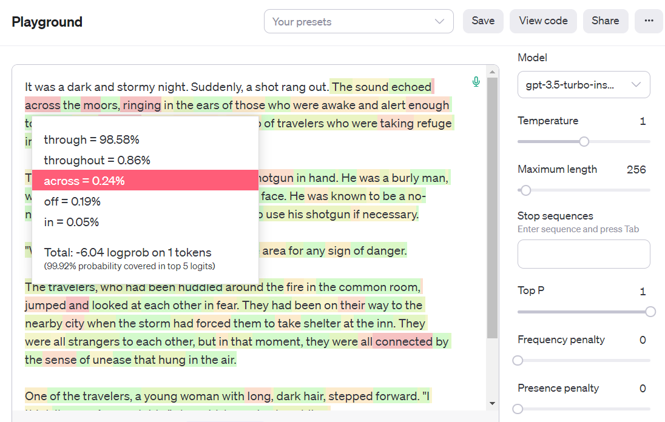
Notes:
https://platform.openai.com/playground?mode=complete

Slide 8
>>> Information <<<
Representation
Learning
Reasoning

Slide 9
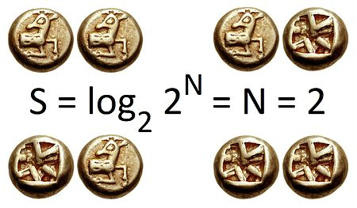
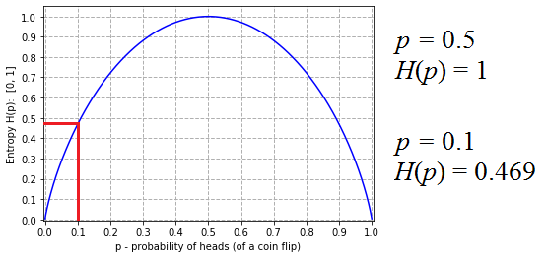
Entropy
Fundamental (mass or energy)
Metric of uncertainty/disorder (no time, isolation, events-messages)
Compression ~ Intelligence (id patterns, efficient representations, feature extraction, prediction, generalization)

Slide 10
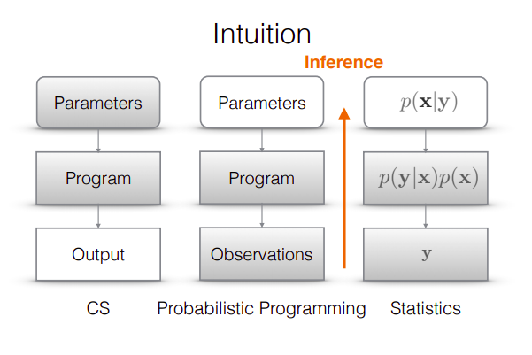
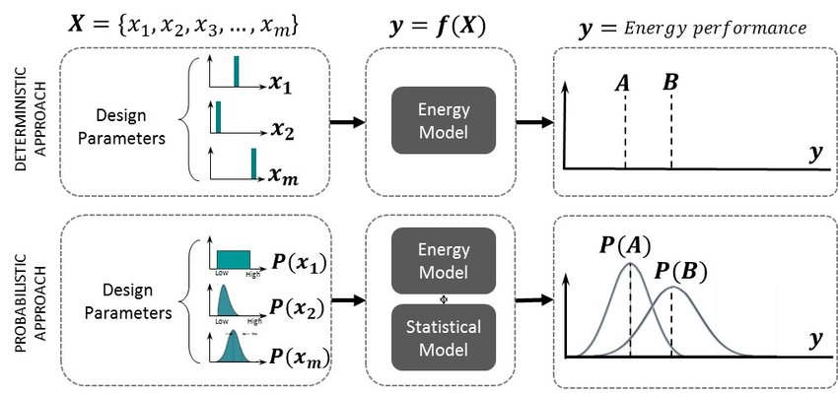
Probabilistic Thinking
Deterministic to Probabilistic
Point Value to Distributions
Implicit to Explicit Approximations
Notes:
https://towardsdatascience.com/intro-to-probabilistic-programming-b47c4e926ec5
https://www.tensorflow.org/probability
https://www.researchgate.net/figure/Deterministic-approach-vs-probabilistic-approach-in-the-design-decision-making-comparing_fig5_282774927

Slide 11
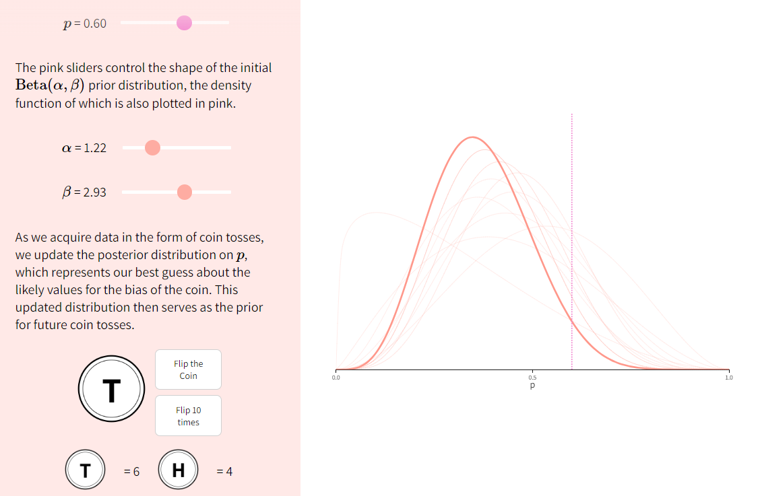
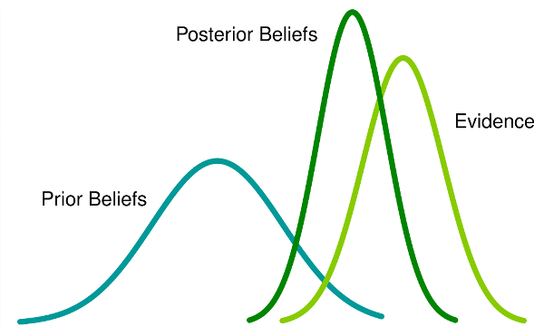
Distribution Sampling & Types
Notes:
https://seeing-theory.brown.edu/bayesian-inference/index.html#section1

Slide 12
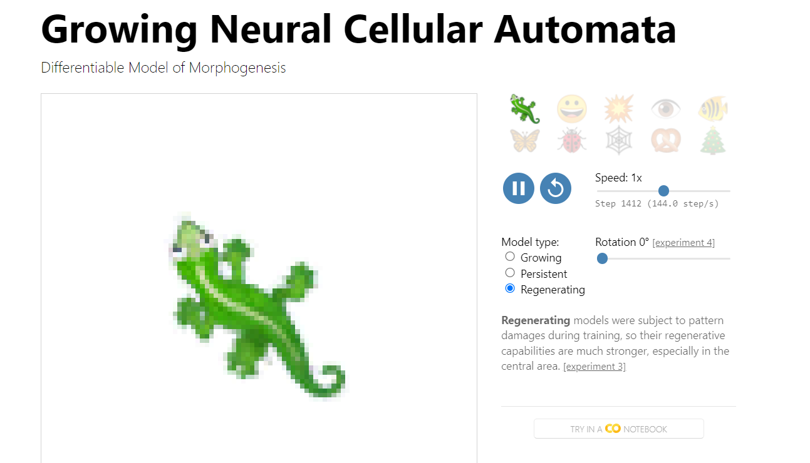
Information: Data is Code is Data
Notes:
https://distill.pub/2020/growing-ca/

Slide 13
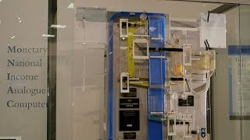
Information > Modality: MONAIC vs TensorFlow
Notes:
https://www.youtube.com/watch?v=rAZavOcEnLg

Slide 14
Information
>>> Representation <<<
Learning
Reasoning

Slide 15
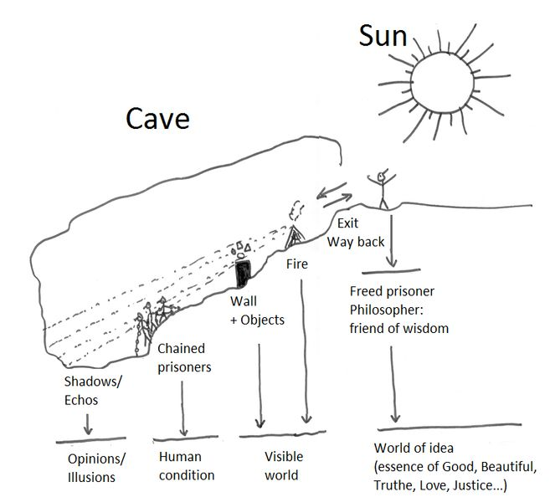

Plato’s Cave

Slide 16
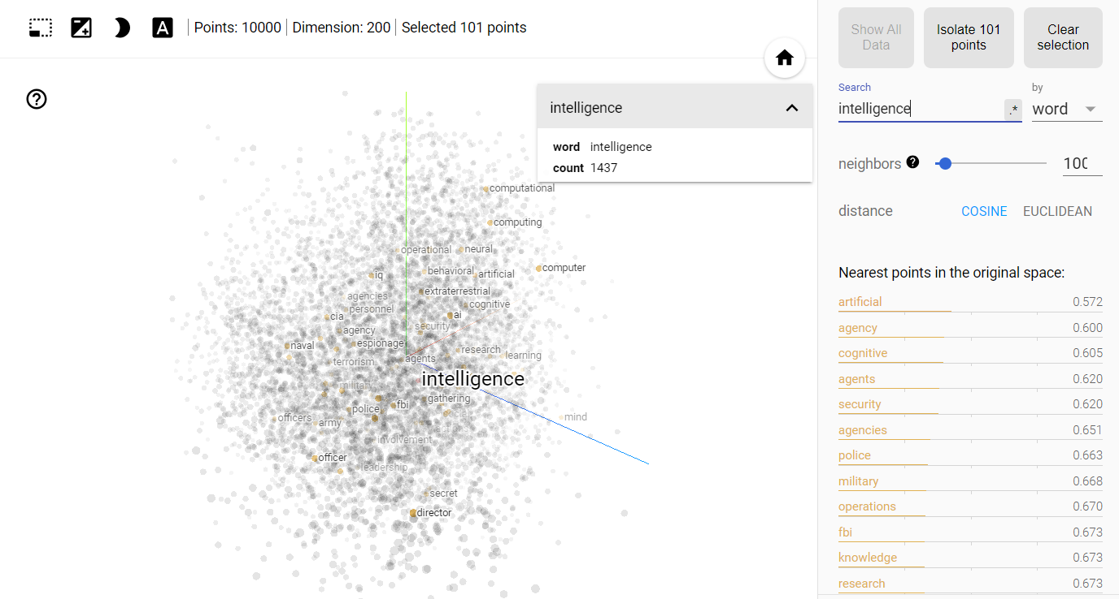
Revealing Latent Semantic Structure in Language
Notes:
https://projector.tensorflow.org/
Quantifying the Arbitrary:

Slide 17
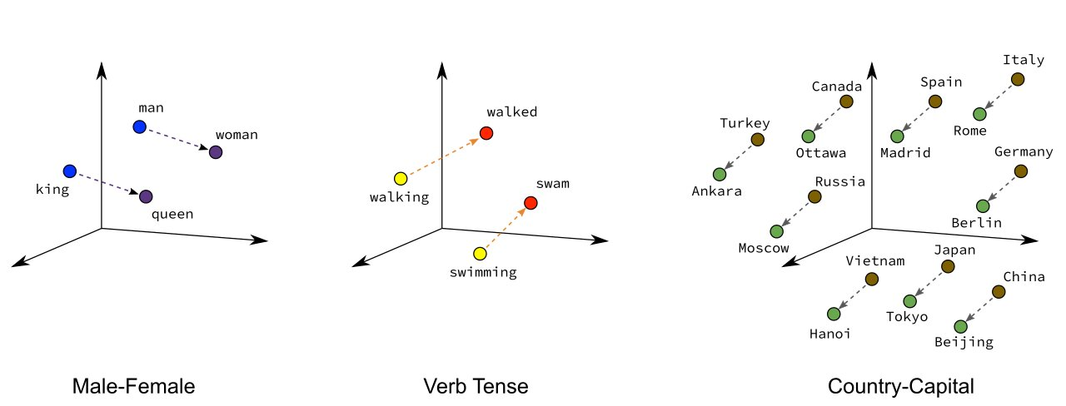
Semantically Meaningful Dimensions
Notes:
https://projector.tensorflow.org/
Quantifying the Arbitrary:

Slide 18
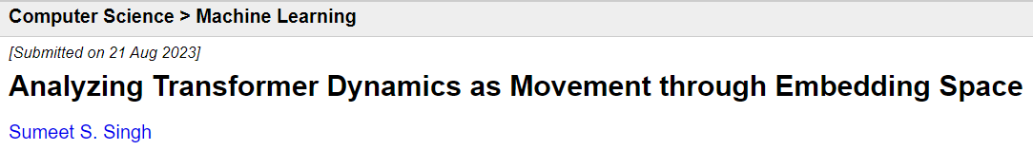
Latent < [Semantic] < Manifolds
OPERATION:
1. Up-sampling Embeddings (Viz)
2. Down-sampling Dimensionality Reduction/Projection (3D to 2D, pros/cons)
3. Change of Basis
4. Structure: None, Algebraic, and Geometric/Topological
GOAL: Feature Engineering & Semantic Algebra (Viz)
CHALLENGES:
Coverage
OOV
Sample Efficiency
High Dimensionality (sparsity/curse of dimensionality, overfitting, stability, interpretability, etc.)
RESEARCH
Cognition as 1. goal-oriented transformations of in latent space and/or 2. directed movement within
Notes:
https://arxiv.org/pdf/2308.10874.pdf

Slide 19
Transformations

Slide 20
Information
Representation
>>> Transformations <<<
Superposition
Learning
Reasoning

Slide 21
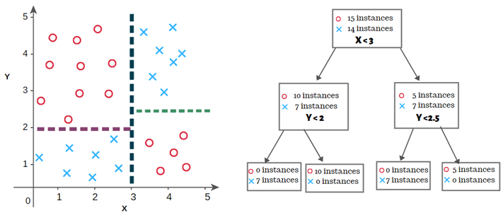
Decision Trees (GOFAI Linear Decision Boundaries)

Slide 22
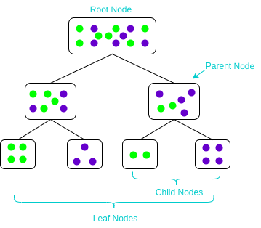
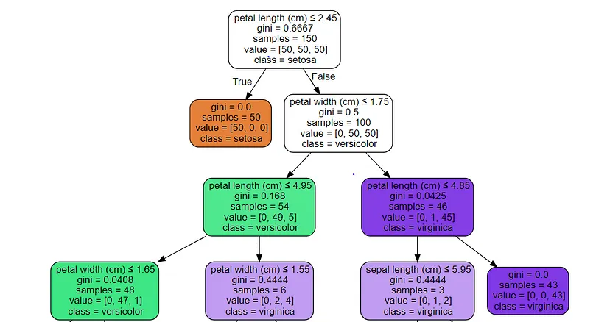
Objective Function: Min(Entropy) in Children Nodes
Notes:
https://www.analyticsvidhya.com/blog/2020/06/4-ways-split-decision-tree/

Slide 23
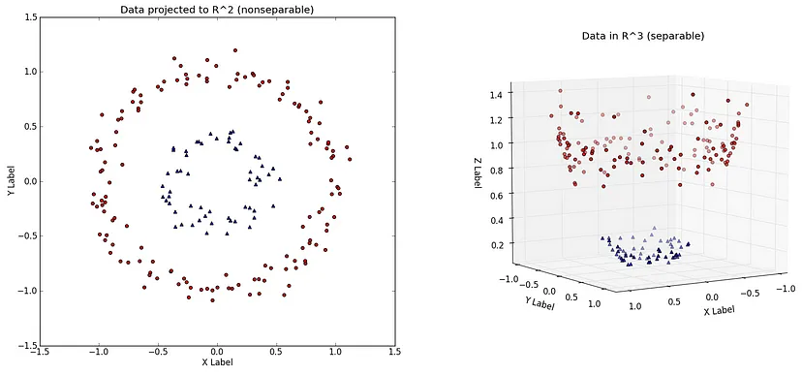
Linear Classifier
(Transform to enable
Linear separation)

Slide 24
Transform to
Higher Dimension

Slide 25
Superposition

Slide 26
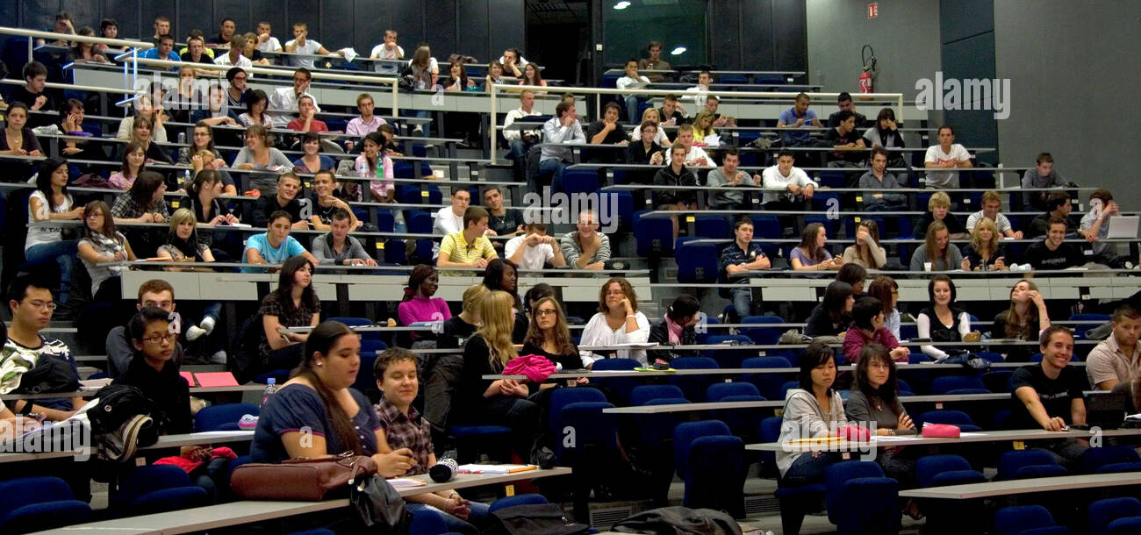
Find 3 Transformations to Meaningful Semantic Spaces
Inferring Semantic Spaces

Slide 27
Working in Semantic Space

Slide 28
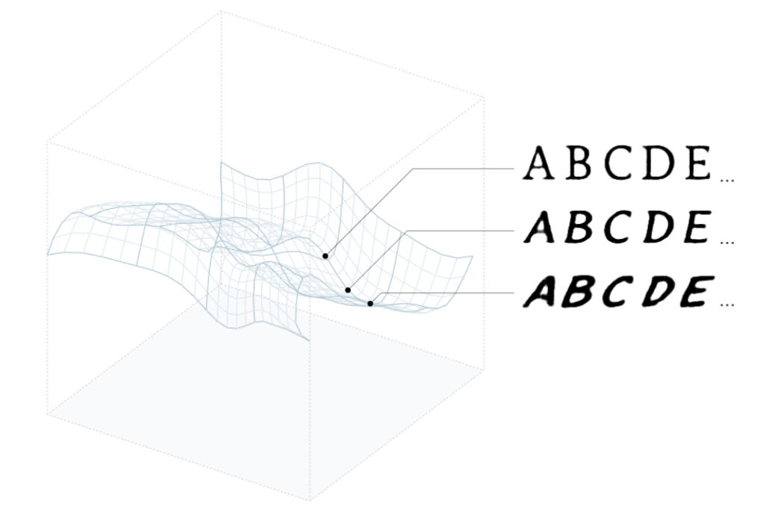
Semantic Spaces
with
Meaningful
Dimensions
Notes:
https://distill.pub/2017/aia/

Slide 29
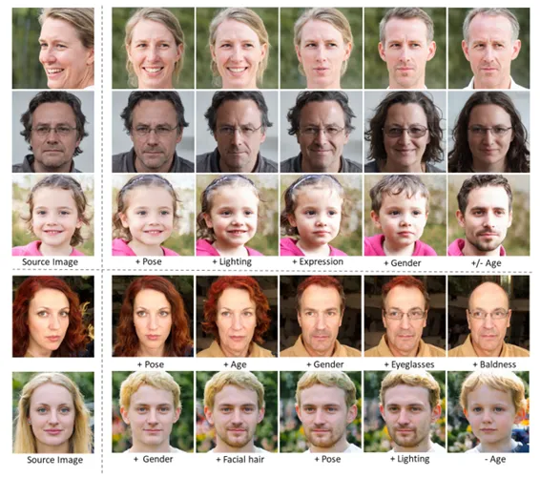

Slide 30
Latent Space of Models
Encoded with Language
“Sherlock saw the man with binoculars.”
(1-5% Aphantasia)

Slide 31
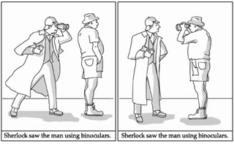
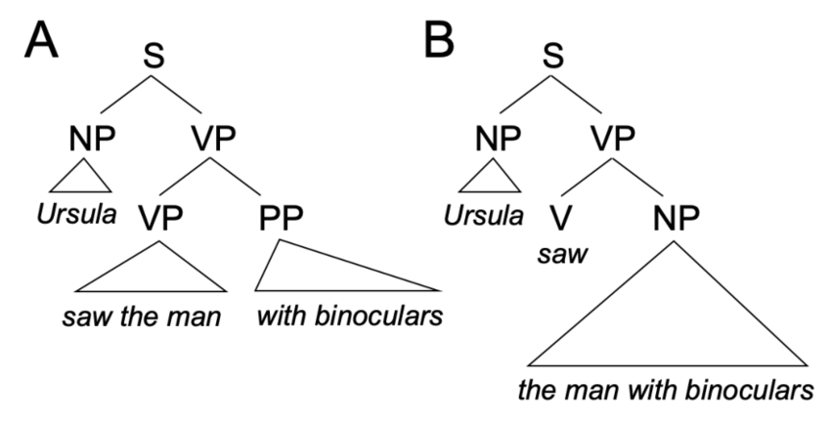
Natural Language
Vs
Constructed Languages
(Examples?)

Slide 32
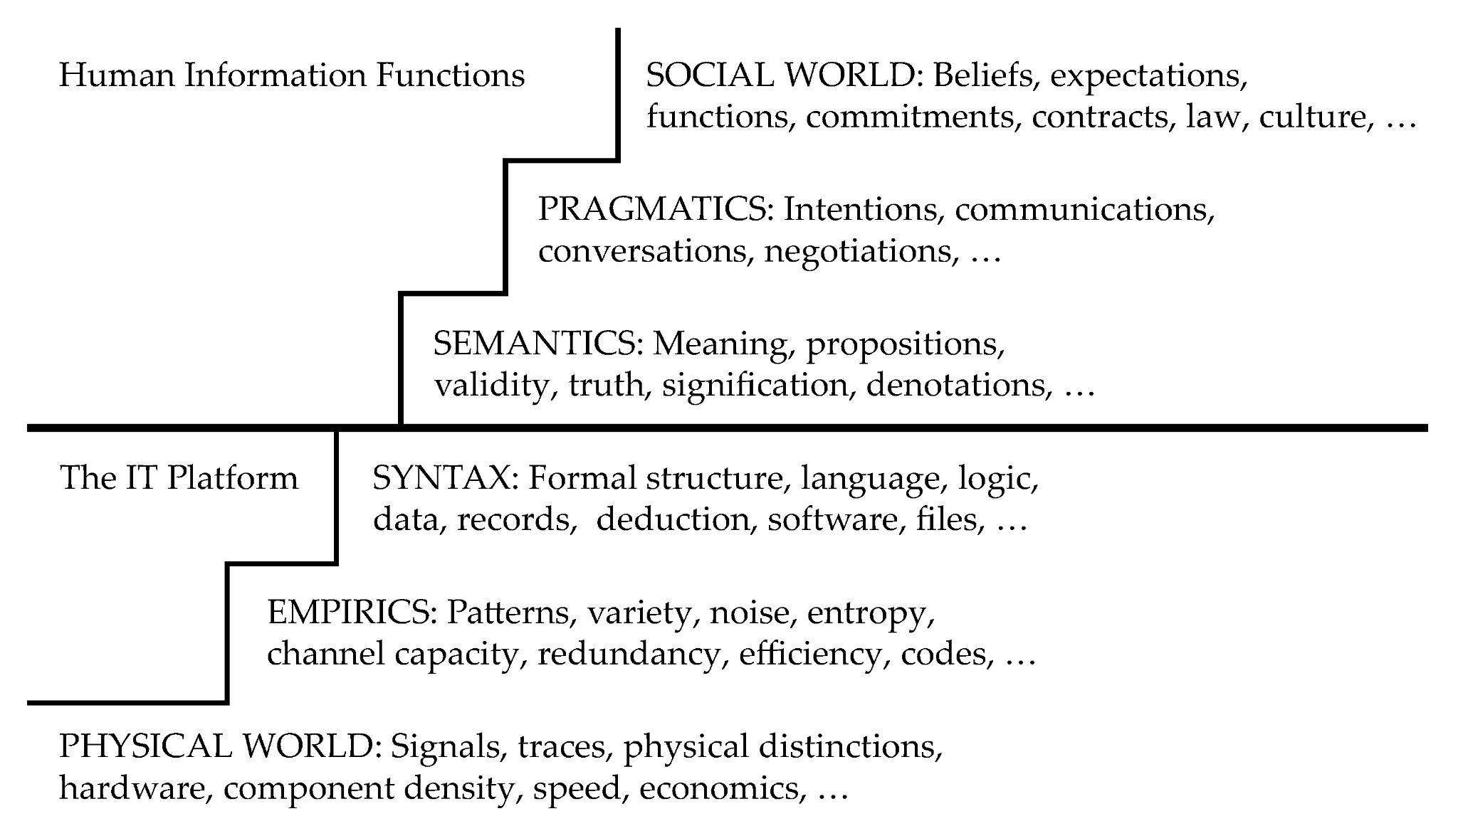
Semiotics to Linguistics to NLP
Notes:
https://www.mdpi.com/1999-5903/15/7/239

Slide 33
Learning

Slide 34
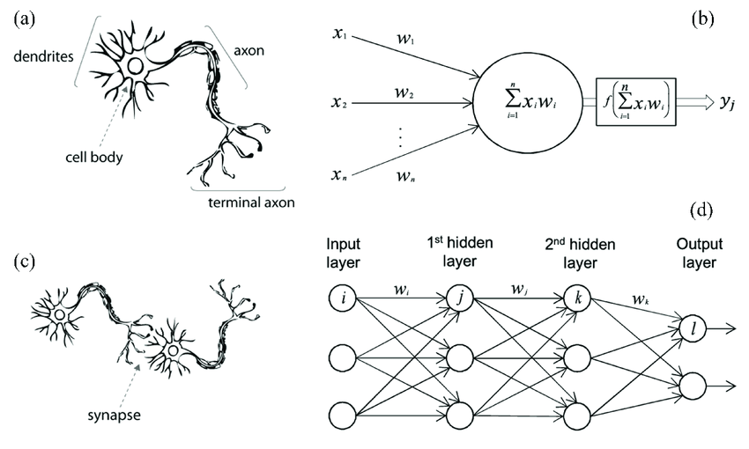
Deep Neural Networks

Slide 35
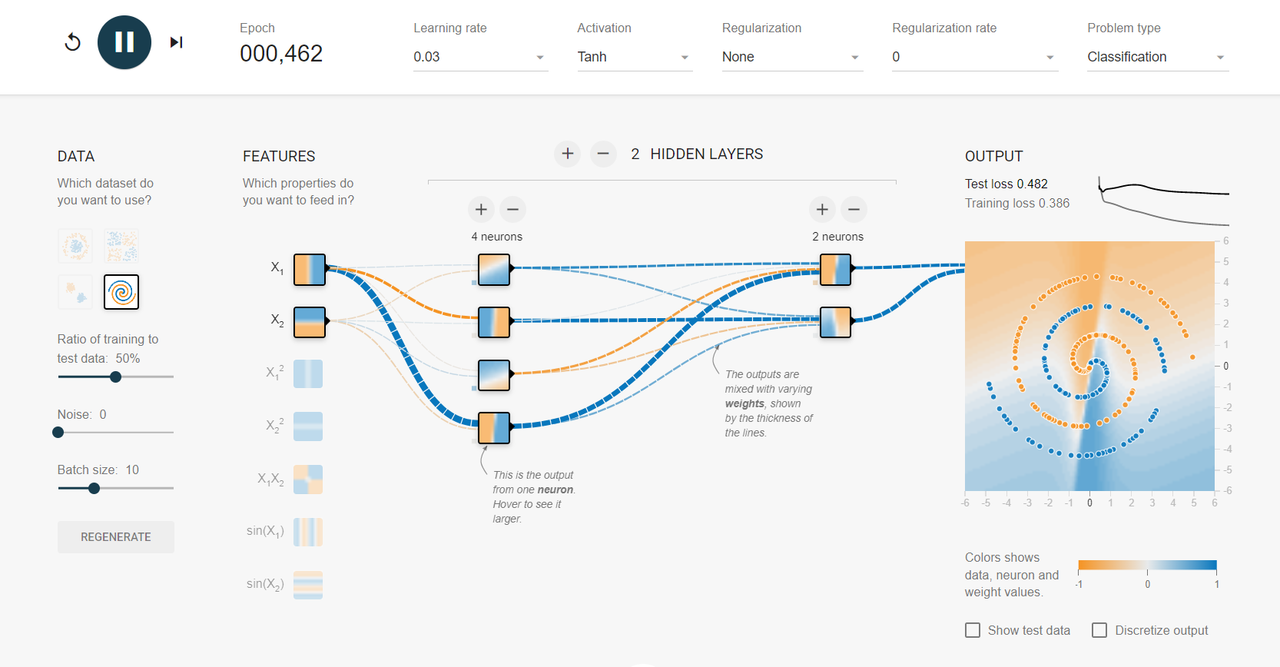
Universal Function Approximator
Notes:
https://playground.tensorflow.org

Slide 36
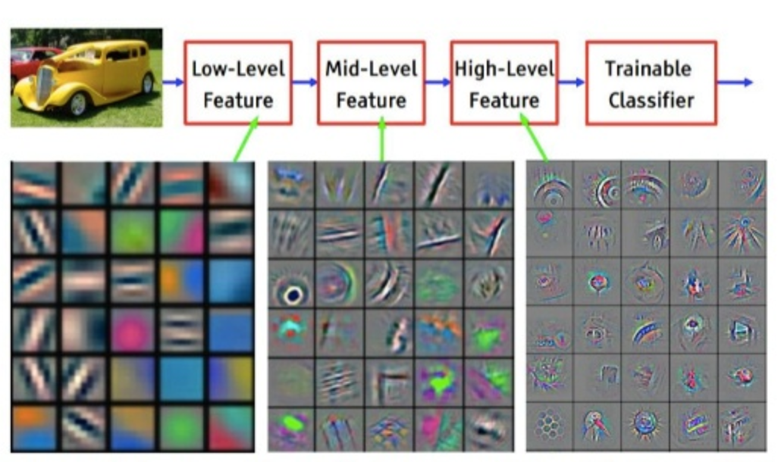
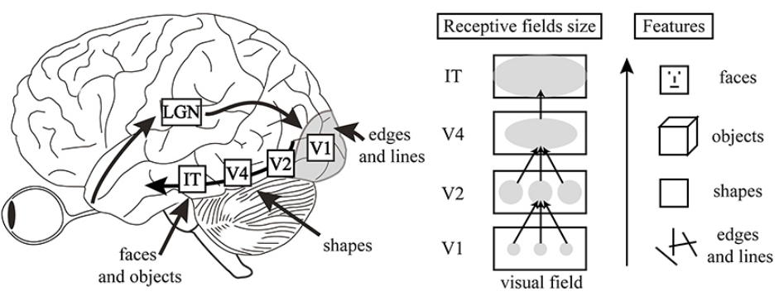
Efficient Architecture for Spatial Feature Detection (CNN)
Notes:
https://msail.github.io/post/cnn_human_visual/

Slide 37
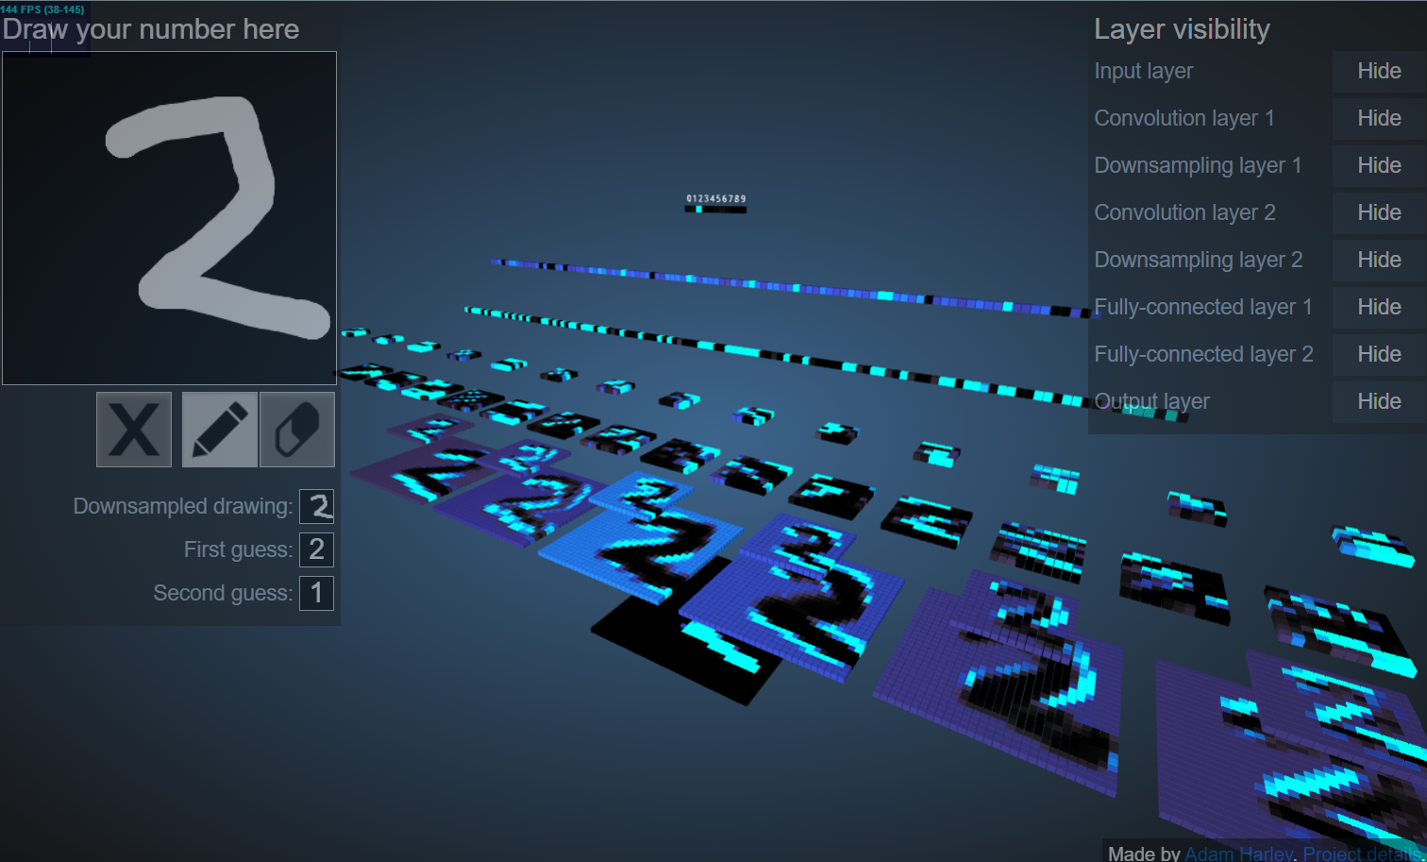
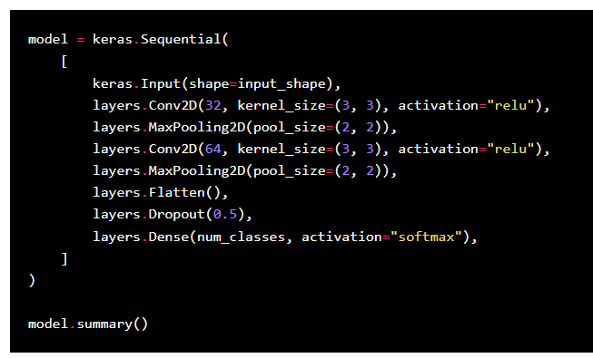
CNN for Spatial Processing
Notes:
https://adamharley.com/nn_vis/cnn/3d.html
https://keras.io/examples/vision/mnist_convnet/

Slide 38
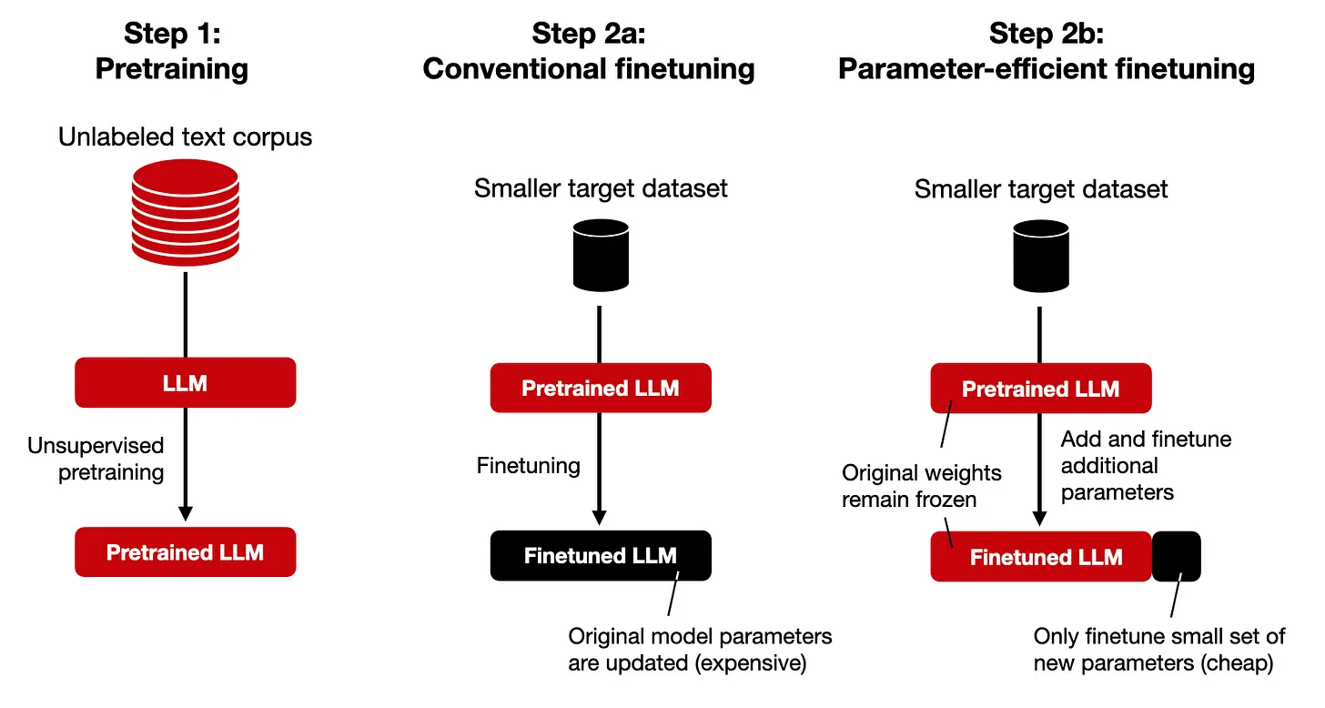
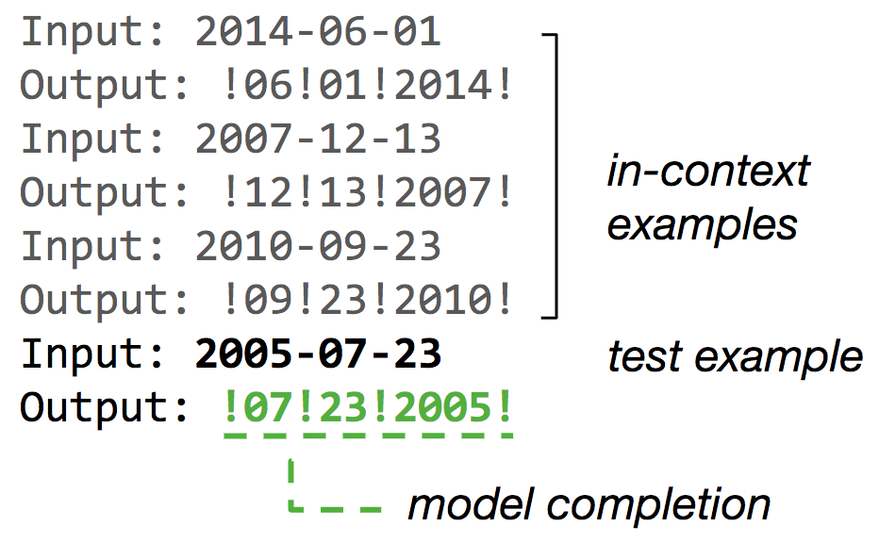
Injecting Information into LLMs
Pre-Training: autoregressive next word prediction (Language)
Fine-Tuning: instruct patterns (Skills/Behaviors)
Prompting: n-shot In-Context Learning (ICL)
Tools (RAG, DB/KB, etc)
Notes:
https://arxiv.org/abs/2305.18654
https://www.youtube.com/watch?v=I_JrRMqL8zk

Slide 39
Reasoning

Slide 40
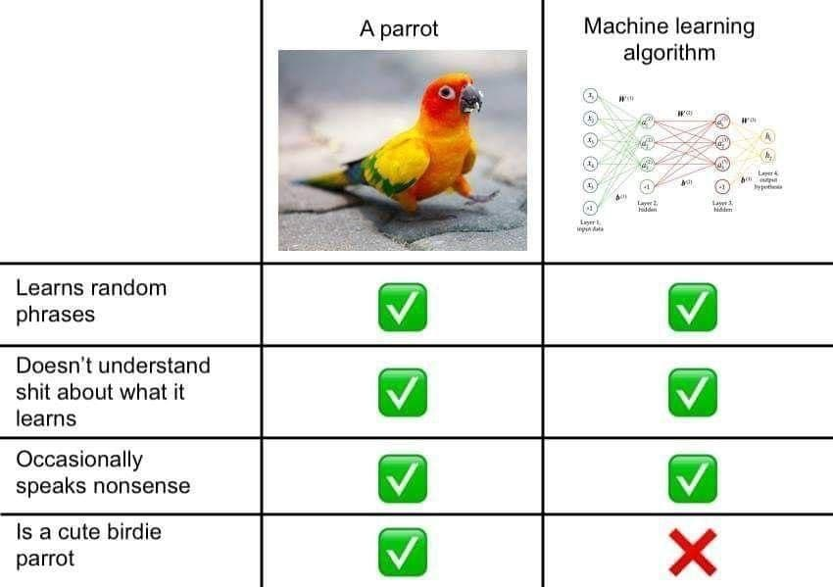
LLM: Reasoning
Prompt Strategies:
CoT
Reflection
ReAct
Agents
Rational
Collaborative
Tool Use/Making
Embodied
Autonomous

Slide 41
LLM Architecture

Slide 42
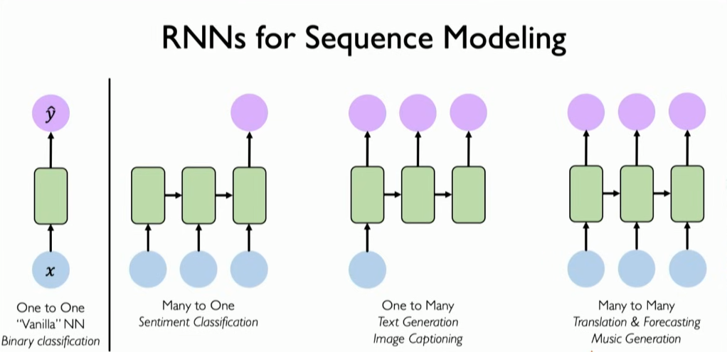
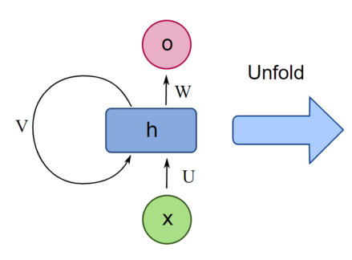
Efficient Architecture for Temporal Feature Detection (RNN)

Slide 43

Transformer
Architecture
Spatial
or
Temporal
in any
Modality

Slide 44
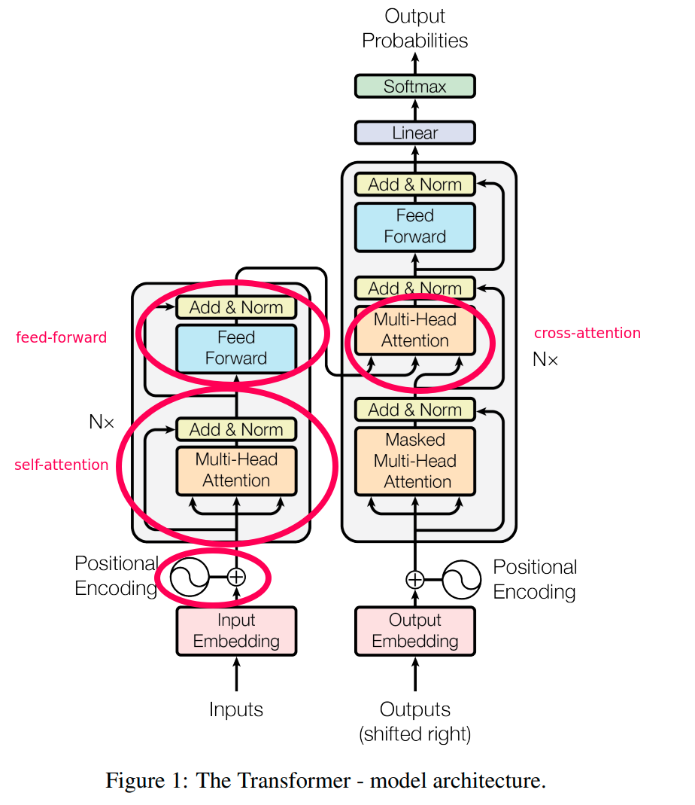
Transformers
Hyperparameters:
Vocabulary
(~30k-50k)
Context Window
(2k to +100k)
hx Heads
Nx Encoders
Nx Decoders

Slide 45
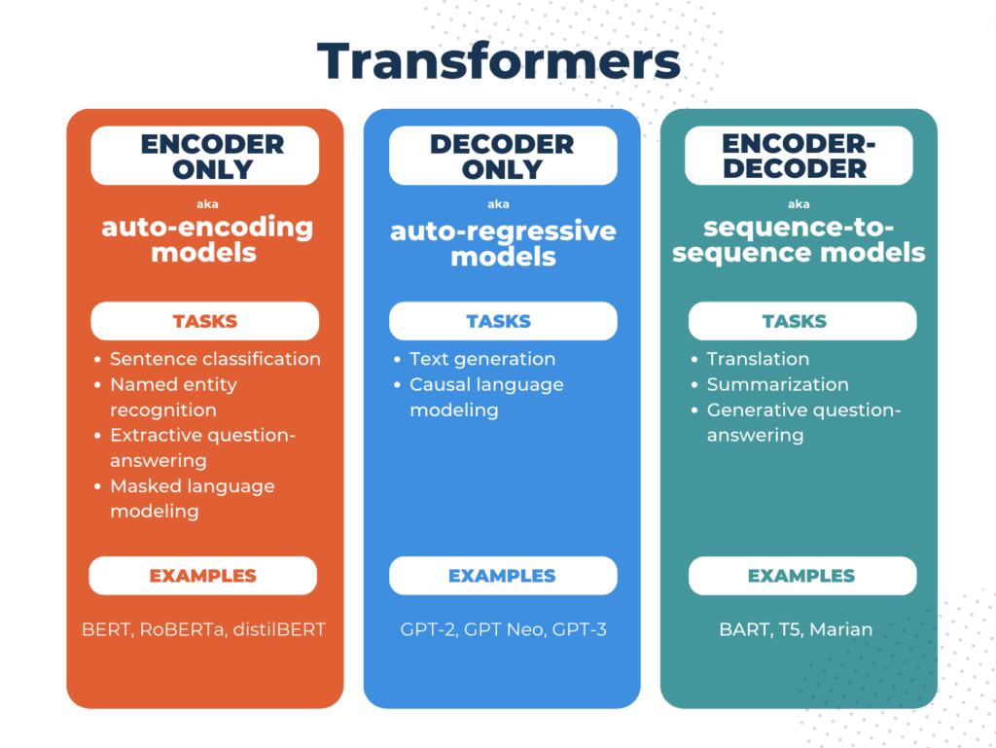
3 Variants

Slide 46
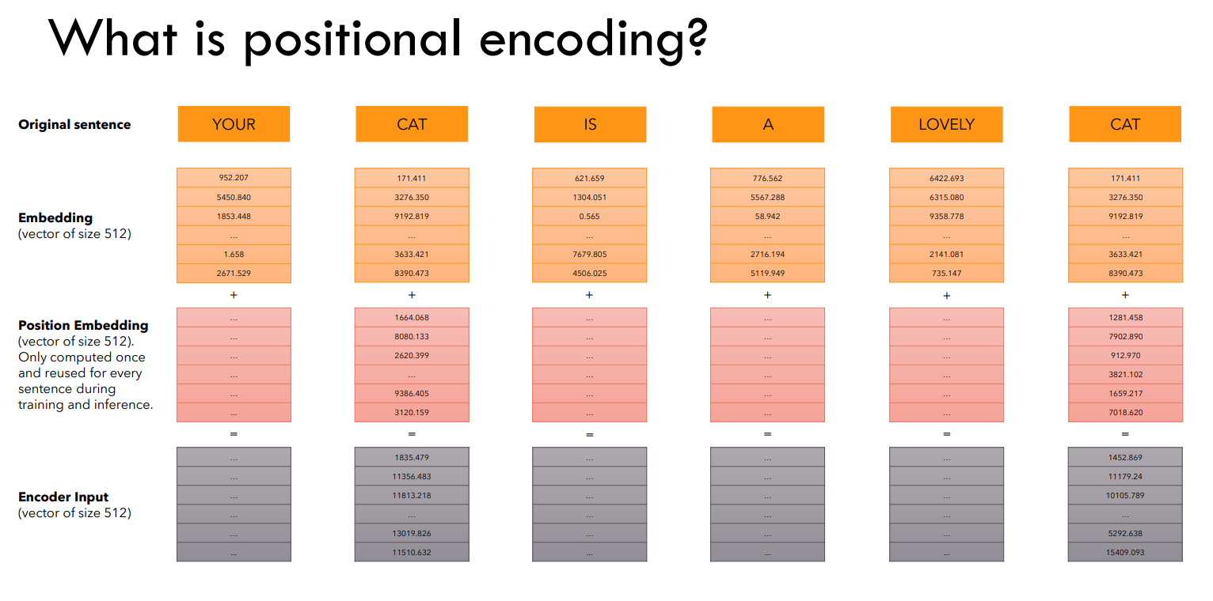
Token Embeddings + Positional Encoding
Notes:
https://www.youtube.com/watch?v=bCz4OMemCcA

Slide 47
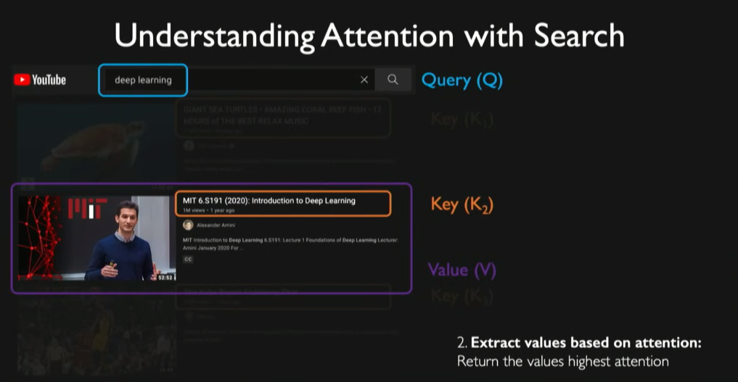
Transformers

Slide 48
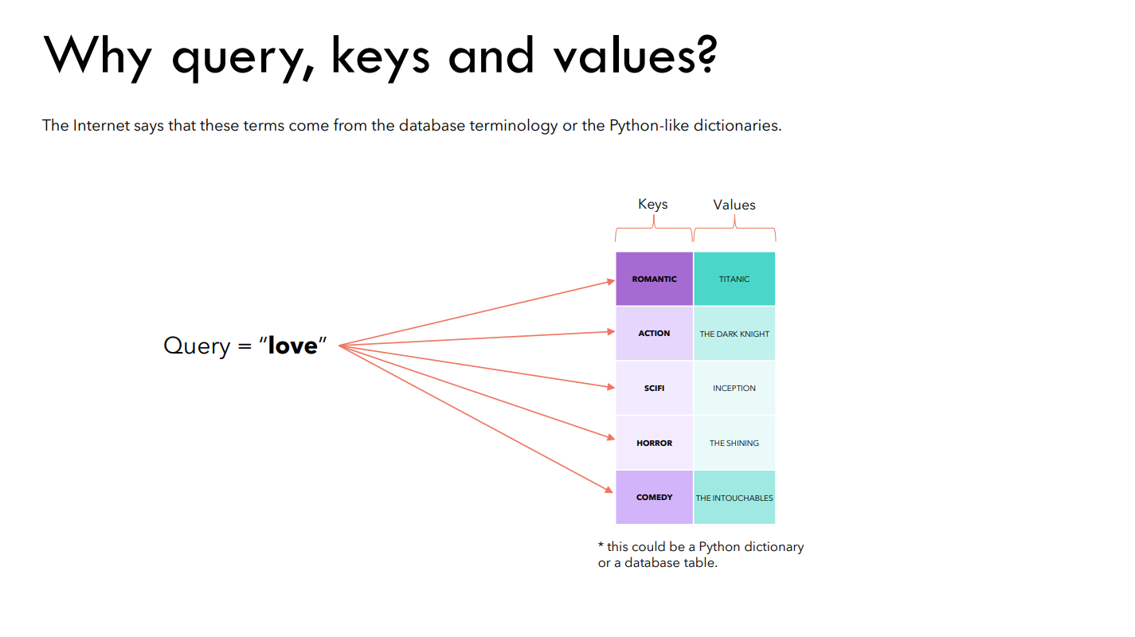
Self-Attention
Notes:
https://www.youtube.com/watch?v=bCz4OMemCcA

Slide 49
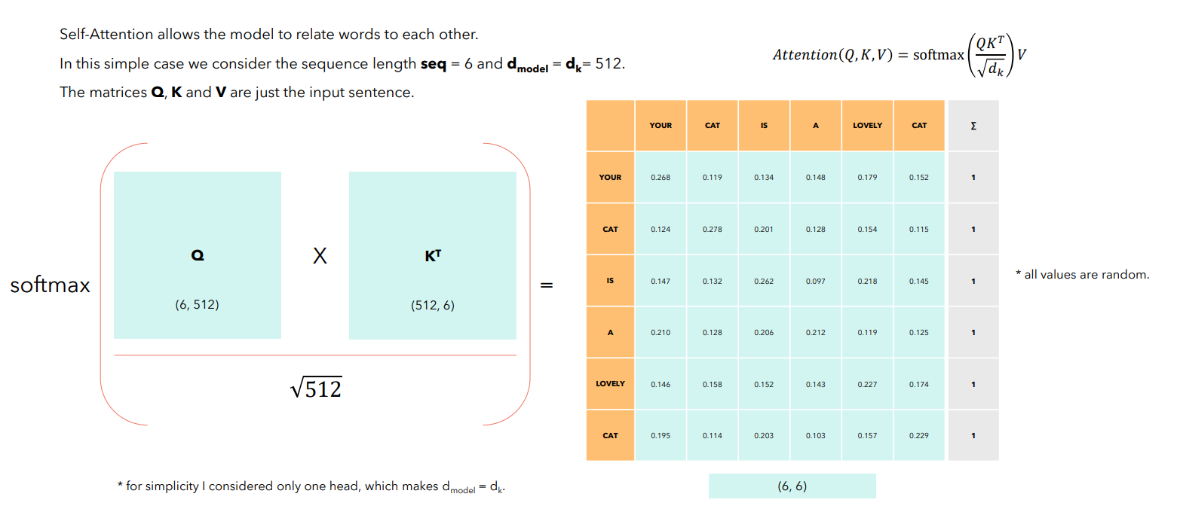
Self-Attention
Notes:
https://www.youtube.com/watch?v=bCz4OMemCcA

Slide 50
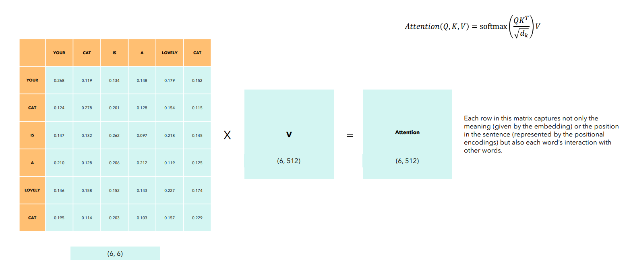
Self-Attention
Notes:
https://www.youtube.com/watch?v=bCz4OMemCcA

Slide 51
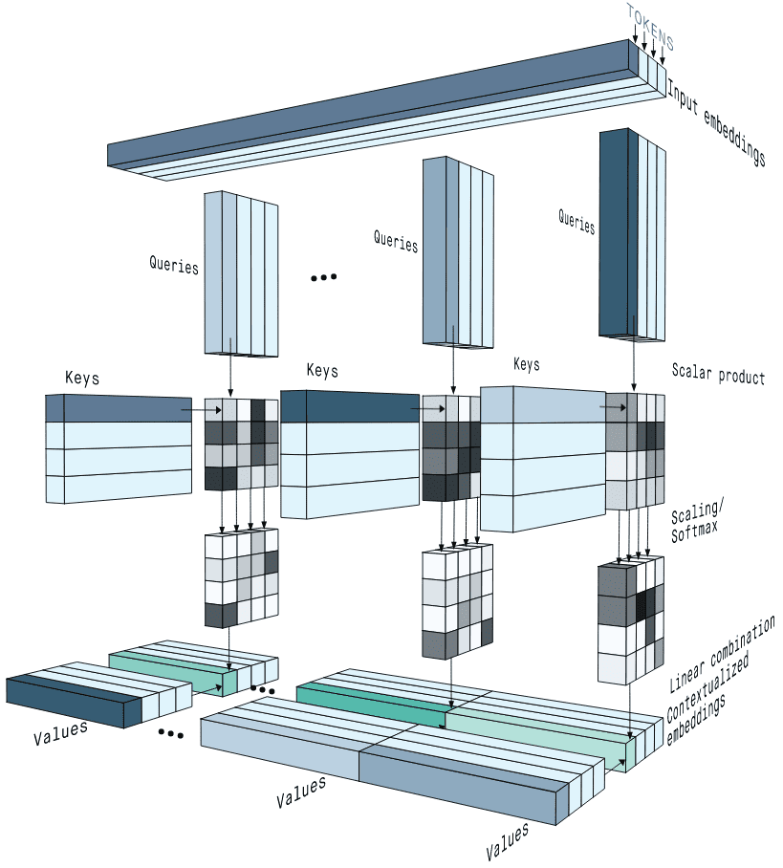
Notes:
https://theaisummer.com/self-attention/

Slide 52
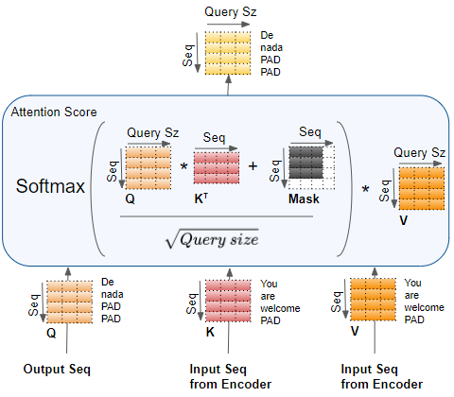
Notes:
https://theaisummer.com/self-attention/

Slide 53
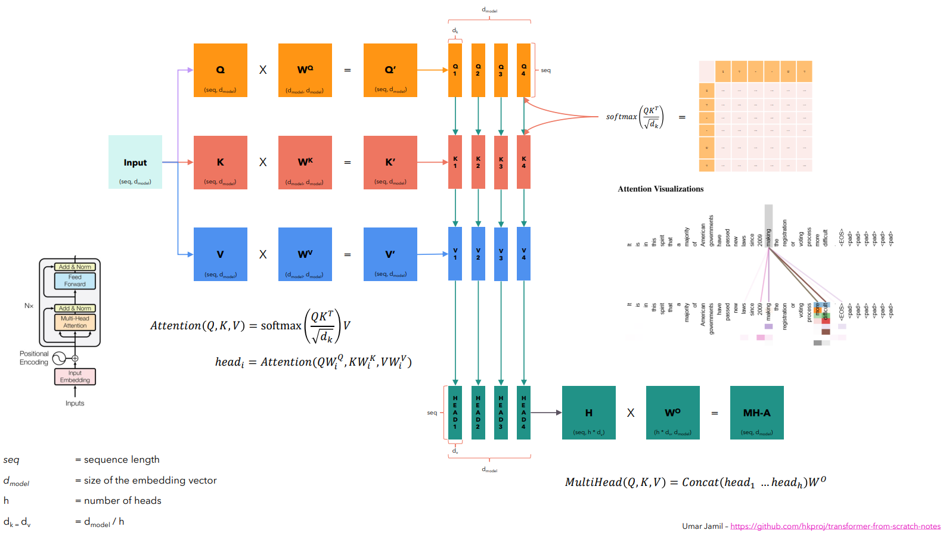
Notes:
https://www.youtube.com/watch?v=bCz4OMemCcA

Slide 54
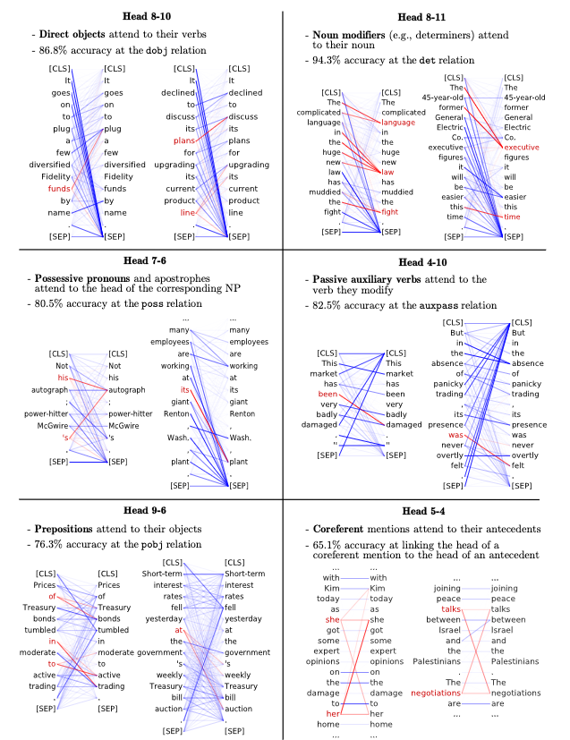
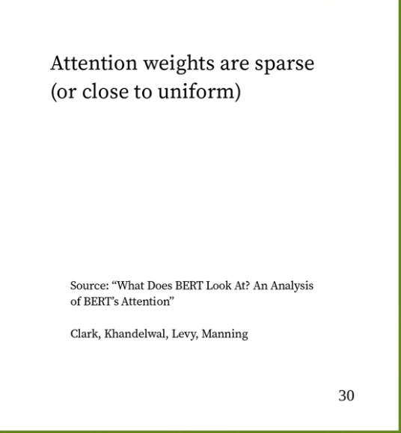
Attention
Notes:
https://www.youtube.com/watch?v=MSw8HV0eHo8
https://arxiv.org/pdf/1906.04341.pdf

Slide 55
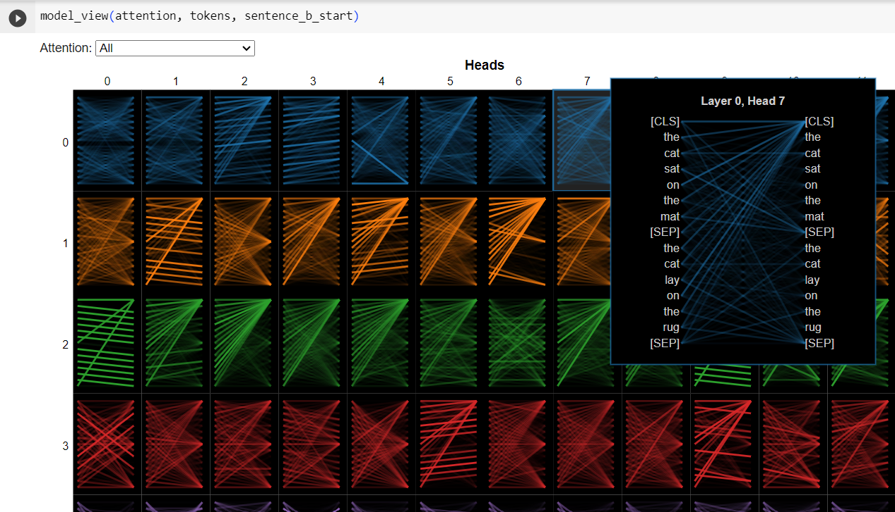
BERTViz Attention Heads
Notes:
https://github.com/jessevig/bertviz

Slide 56

Superposition of Semantic Spaces
Notes:
https://www.youtube.com/watch?v=lmepFoddjgQ&t=180s

Slide 57

Visualize (Q x K) x V Matrix Cosine Similarities
Notes:
https://www.youtube.com/watch?v=lmepFoddjgQ&t=180s

Slide 58
LLM Inference
Notes:
https://www.youtube.com/watch?v=IGu7ivuy1Ag&t=1847s How a Transformer works at inference vs training time

Slide 59

Next Token Probabilities
Notes:
Temperature — LLMs. In the context of a language model, the… | by Amansinghalml | Medium

Slide 60
Notes:
https://platform.openai.com/playground?mode=complete

Slide 61

Inference Hyperparameters
Notes:
Temperature — LLMs. In the context of a language model, the… | by Amansinghalml | Medium

Slide 62

Top-P
+
Hi Temp
~ MCMC Sampling
Notes:
Diverse Title Generation for Stack Overflow Posts with Multiple Sampling Enhanced Transformer – arXiv Vanity (arxiv-vanity.com)

Slide 63


Beam Search
Notes:
https://huggingface.co/blog/how-to-generate

Slide 64

Notes:
GPT - OpenAI API

Slide 65

Notes:
API Reference - OpenAI API

Slide 66

Notes:
Logprob value is unbounded, i used sigmoid (converting API logarithm to probabilities) - API - OpenAI Developer Forum

Slide 67
Prompt Engineering
Simple Prompts
N-shot In Context Learning (ICL)
Reflection
Chain of Thought
Tree of Thought
ReAct

Slide 68
Future

Slide 69

Future
New Best Friend: pi.ai Chatbot
LMM
Automated Agents
XAI & FATE
Small Open LLM
Affective AI
Theoretical Basis
Notes:
https://pi.ai/home

Slide 70
Fin

